Slide 1
Demystifying AI
June 30, 2021

Slide 2


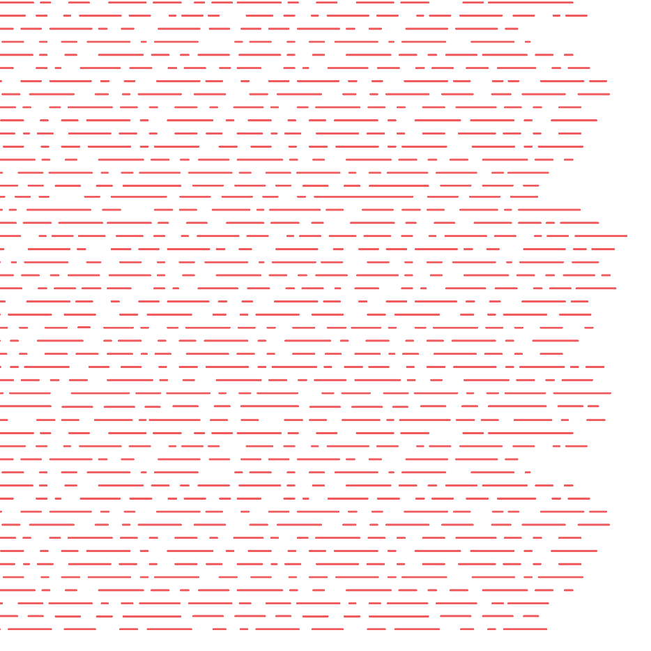


Vision
Mission
To realize the full health
potential of every human, everywhere.
Reform the global health ecosystem through the power of information and technology.

Slide 3
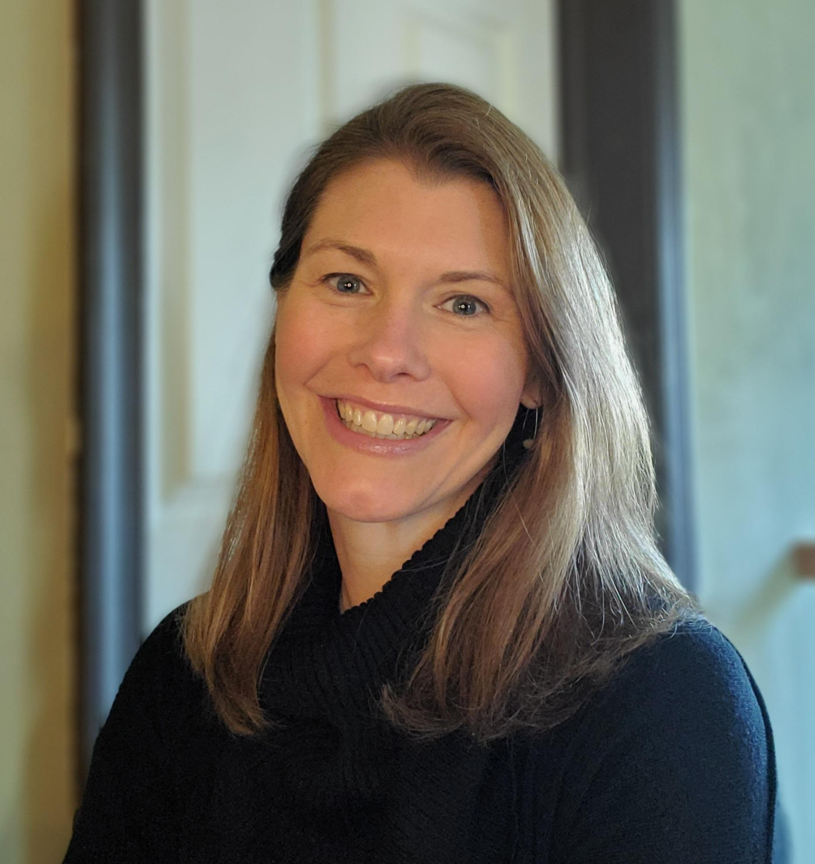
Welcome
Gwynne Jelbaoui
Program Manager
Clinical Informatics HIMSS
Gwynne.Jelbaoui@himss.org
Notes:
GWYNNE

Slide 4






Education
Community
Present webinars on telehealth, medical informatics, clinical decision support and best use of EHR systems
Volunteer efforts include –CMIO Roundtable & Workgroups, Clinician Circle (ambassador)
Thought Leadership
CMIOs
Value of CMIO; CMIO Roundtable
Policy input, interviews with HIMSS Media; Pre-Con Symposium Planning
Physician Community
Education Task Force
Physician Resources
Drive education and content for Community
Career profiles, education, articles, blogs
www.himss.org/membership-participation/physician
Strategic Partners
AMDIS, PEHRC with CMSS, AHA
Notes:
Has a Physician Community member, you will
Be a part of a community of volunteers who work toward building CMIO roundtables, workgroups, and the clinician circle program
Network with CMIOs; the majority of the Committee members are CMIOs
Have the opportunity to take part in the education task force
We can’t do all this on our own; you will have the opportunity to work with strategic partners
Have the accessibility to physician resources, such as education, industry and roles specific articles, career profiles
Have the opportunity to provide input on current governmental policies, participate with HIMSS media, and if interested, assist with the preconference symposium planning
Education, education, education – we are always looking for ways to provide easy to consume information that physicians need to know on trending topics in the clinical informatics industry, whether it be on telehealth, artificial intelligence, best practices with EHR systems.

Slide 5
Demystify AI
Learning Objectives
Explain the fundamentals of AI and Natural Language Processing (NLP) technology
Identify healthcare related problems and opportunities where AI and Natural Language Processing (NLP) applications play a role
Understand the preconditions for successful application of AI solutions in healthcare
List several AI-based healthcare systems or NL solutions in use today.

Slide 6
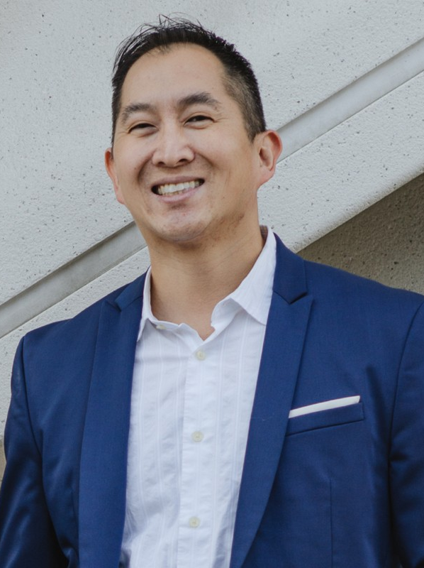
Alan Young, MD, MBA, PMP
Dr. Alan Young is a physician innovator and strategist with diverse clinical, corporate and entrepreneurial accomplishments.
Currently the Head of Clinical Partnerships at KelaHealth building AI-powered solutions for surgery. He also serves on the HIMSS National Physician Committee, So Cal HIMSS CMIO Committee Chair and is a member of the Scale Health Steering Committee.

Slide 7
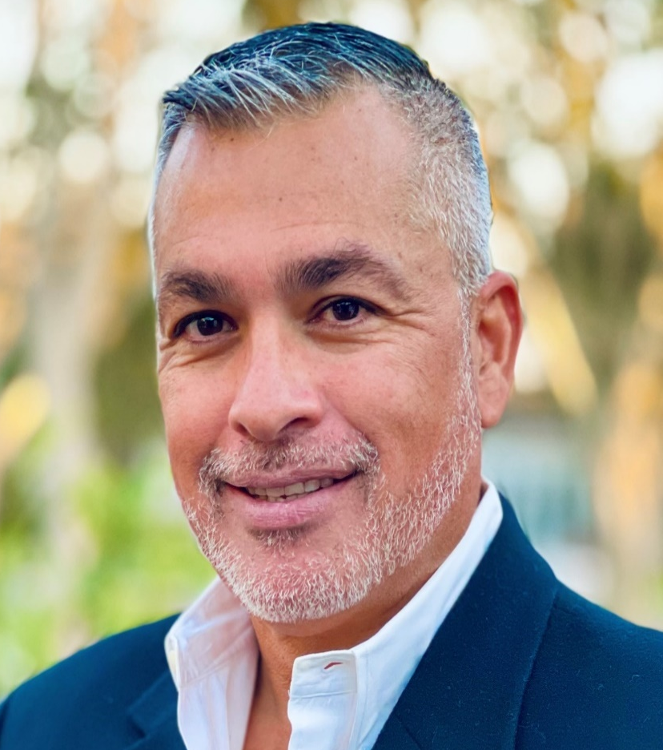
Eric Quinones, MD
Chief Healthcare Advisor
World Wide Technology

Slide 8
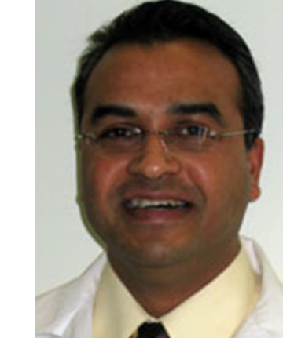
Jai Nahar, MD, MBA
Attending, Division of Cardiology
Children’s National Heart Institute, George Washington School of Medicine
Associate Professor of Pediatrics
Children’s National Hospital

Slide 9
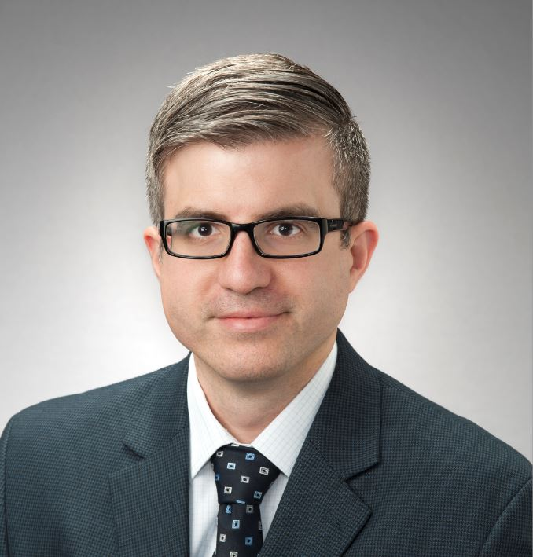
Christopher Horvat MD, MHA
Assistant Professor, Division of Pediatric Critical Care Medicine
Director, Health Informatics for Clinical Effectiveness
Director, Condition A/C Medical Emergency Response Teams
UPMC Children’s Hospital of Pittsburgh

Slide 10


Panel Discussion

Slide 11
Questions from the attendees?

Slide 12


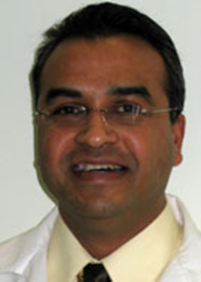
Thank you speakers!
Alan Young, MD, MBA, PMP
Eric Quinones, MD
Jai Nahar, MD, MBA
Christopher Horvat MD, MHA

Slide 13

Thank you!
Contact emails:
Physician Community informatics@himss.org
Gwynne Jelbaoui
Gwynne.Jelbaoui@himss.org

